Slide 1
Lecture 8
DTMC – Limiting Behavior

Slide 2
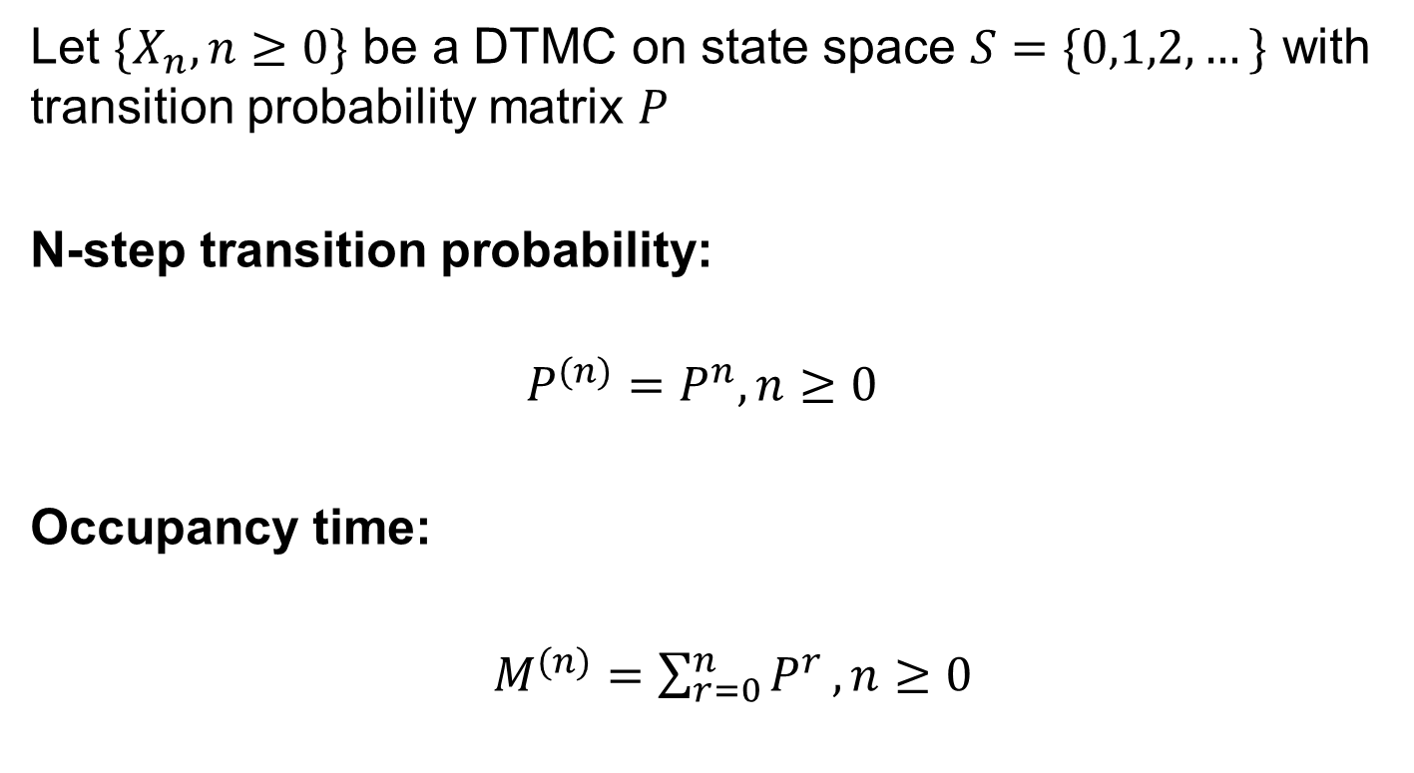
What we know
Let $\{X_{n},n≥0\}$ be a DTMC on state space $S=\{0,1,2,…\}$ with transition probability matrix $P$
N-step transition probability:
$$P^{(n)}=P^{n},n≥0$$
Occupancy time:
$M^{(n)}=\sum_{r=0}^{n}{P^{r}},n≥0$

Slide 3
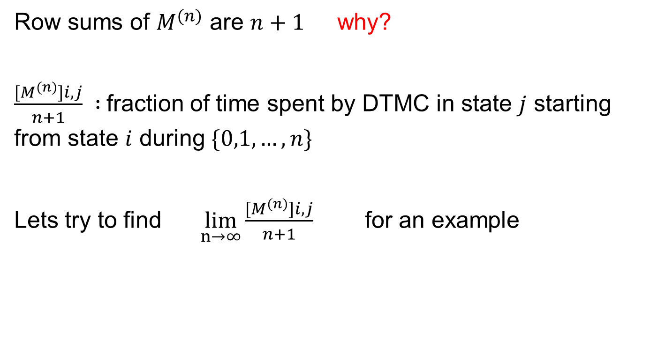
Occupancy Time
Row sums of $M^{(n)}$ are $n+1$ why?
$\frac{{[M}^{(n)}]i,j}{n+1} :$fraction of time spent by DTMC in state $j$ starting from state $i$ during $\{0,1,…,n\}$
Lets try to find $\lim_{n→∞}\frac{{[M}^{(n)}]i,j}{n+1}$ for an example

Slide 4




Example 4.2
0 1 0
q 0 p
0 1 0
$0<p<1, q=1−p$
Using method of diagonalization (see Example 2.26)
$n≥1 n≥0$
$$P=$$
q 0 p
0 1 0
q 0 p
0 1 0
q 0 p
0 1 0
$$P^{(2n)}=$$
$$P^{(2n+1)}=$$

Slide 5


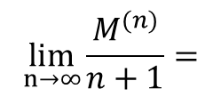
Example 4.2
1+nq n np
nq 1+n np
nq n 1+np
1+nq 1+n np
(n+1)q 1+n (n+1)p
nq 1+n 1+np
$$M^{(2n)}=$$
$$M^{(2n+1)}=$$
q/2 1/2 p/2
q/2 1/2 p/2
q/2 1/2 p/2
$$\lim_{n→∞}\frac{M^{(n)}}{n+1}=$$
Limit exists even when $M^{(n)}$ shows periodic behavior

Slide 6
Classification of States
What will we learn:
Accessibility and communication
Communication class
Irreducibility
Transience
Null recurrence
Positive recurrence
Periodicity

Slide 7
Few things to know
A walk is an ordered string of nodes in n steps in which there is a directed arc from one node to another.
A path is a walk in which no nodes are repeated.
A cycle is a walk in which the first and the last nodes are the same and no other nodes is repeated.

Slide 8
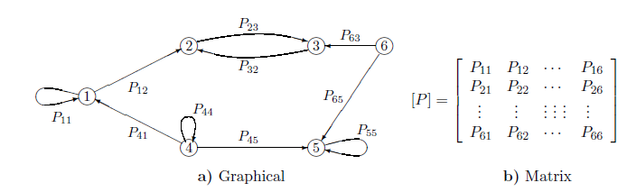
Example
Define a walk from state 1 to state 3.
Define a path from state 1 to state 3.
Is there a cycle from state 1 to state 2 and then back to state 1?
Is there a cycle from state 2 to 2?

Slide 9
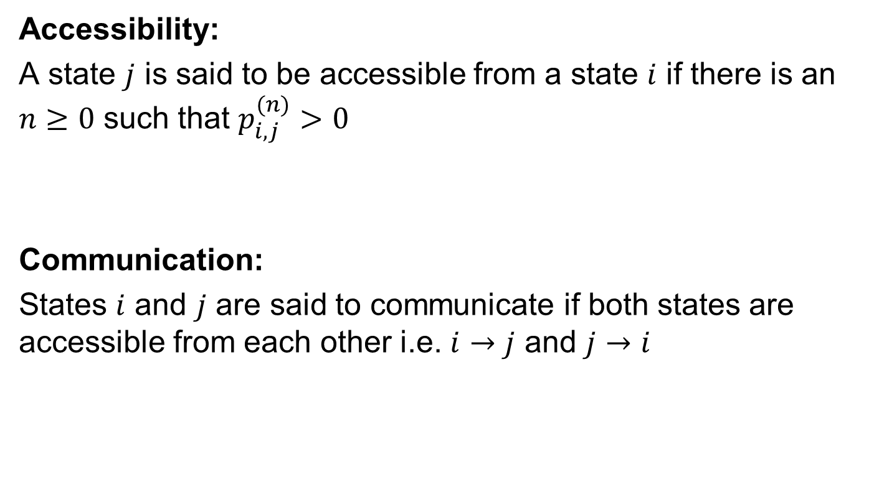
Accessibility and Communication
Accessibility:
A state $j$ is said to be accessible from a state $i$ if there is an $n≥0$ such that $p_{i,j}^{(n)}>0$
Communication:
States $i$ and $j$ are said to communicate if both states are accessible from each other i.e. $i→j$ and $j→i$

Slide 10
Example
Find the states that communicate with each other?

Slide 11
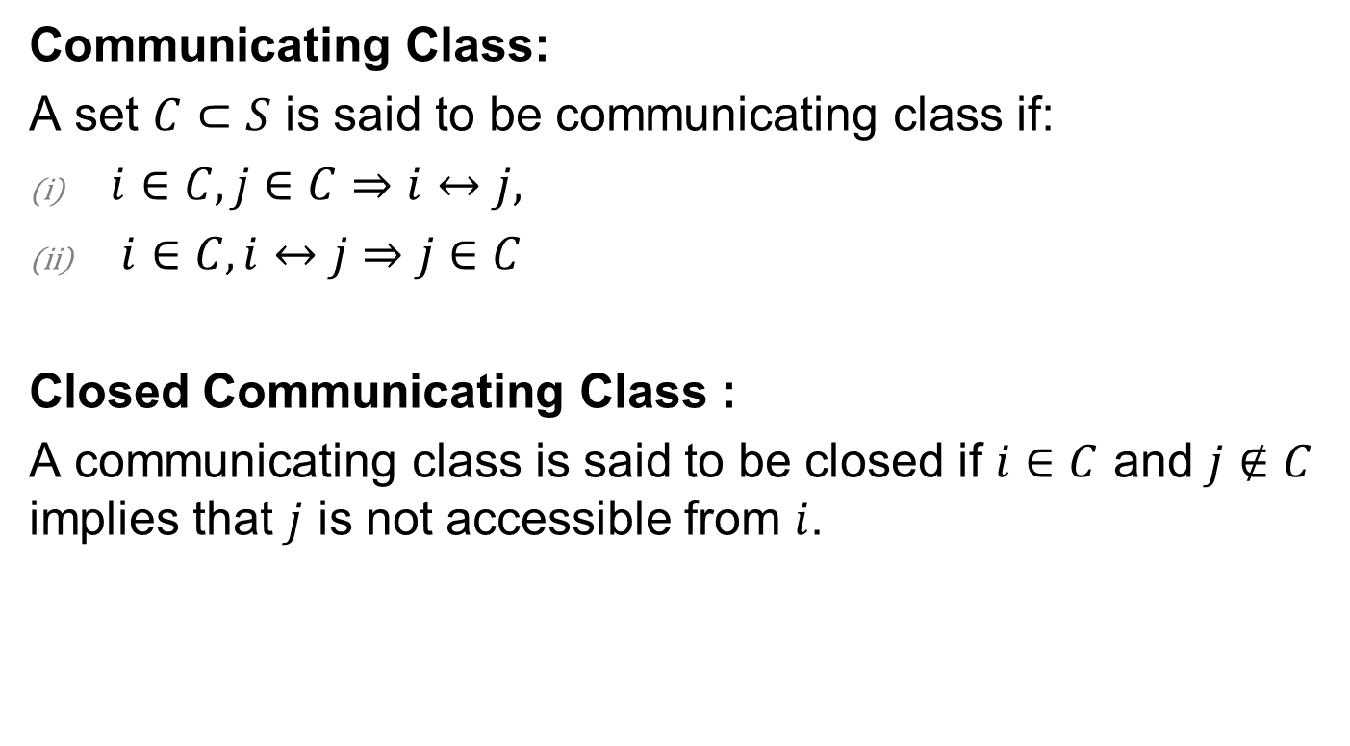
Communicating Class
Communicating Class:
A set $C⊂S$ is said to be communicating class if:
$i∈C,j∈C⇒i↔j,$
$i∈C,i↔j⇒j∈C$
Closed Communicating Class :
A communicating class is said to be closed if $i∈C$ and $j∉C$ implies that $j$ is not accessible from $i$.

Slide 12
Example
Do states 2 and 3 belong to the same class?
Do states 1 and 4 belong to the same class?
Find closed communicating classes?

Slide 13

Irreducibility
Irreducibility:
A DTMC with state space$S$ is said to be irreducible if $S$is a closed communicating class, else it is called reducible.
Is this DTMC irreducible or reducible?
Now lets find another DTMC that is reducible and one that is reducible

Slide 14

Recurrence and Transience
Let $T_{i}^{′}=min\left\{n>0,X_{n}=i\right\}, i∈S$
$u_{i}^{′}=P(T_{i}^{′}<∞|X_{0}=i)$
$m_{i}^{′}=E(T_{i}^{′}|X_{0}=i)$
A state $i$ is said to be:
Recurrent if $u_{i}^{′}=1$
Transient if $u_{i}^{′}<1$
if $u_{i}^{′}<1$then $m_{i}^{′}=∞$

Slide 15
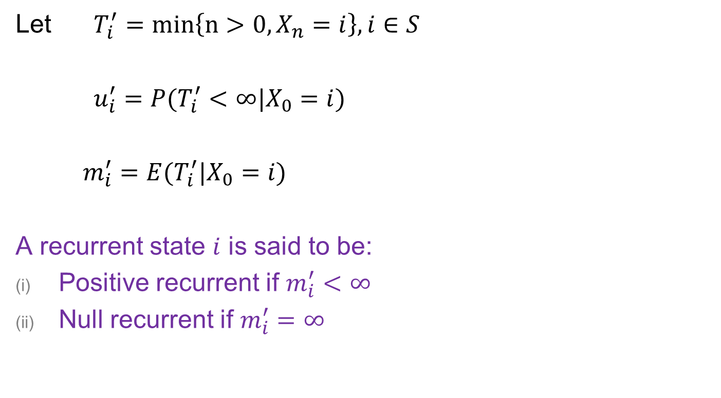
Positive and Null Recurrence
Let $T_{i}^{′}=min\left\{n>0,X_{n}=i\right\}, i∈S$
$u_{i}^{′}=P(T_{i}^{′}<∞|X_{0}=i)$
$m_{i}^{′}=E(T_{i}^{′}|X_{0}=i)$
A recurrent state $i$ is said to be:
Positive recurrent if $m_{i}^{′}<∞$
Null recurrent if $m_{i}^{′}=∞$

Slide 16
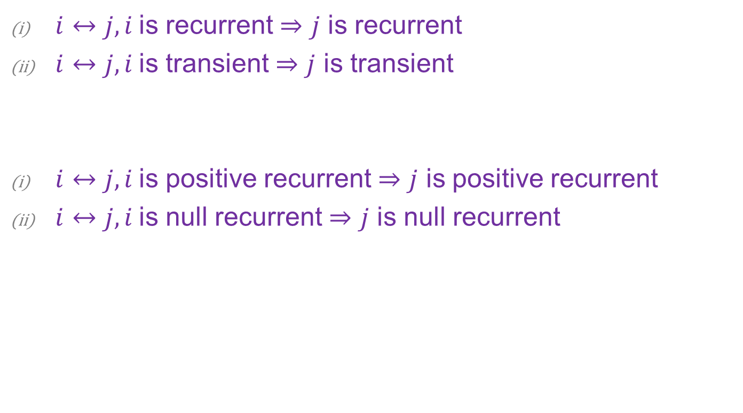
Recurrence and Transience Property
$i↔j, i$is recurrent $⇒j$ is recurrent
$i↔j, i$is transient $⇒j$ is transient
$i↔j, i$is positive recurrent $⇒j$ is positive recurrent
$i↔j, i$is null recurrent $⇒j$ is null recurrent

Slide 17

Periodicity
A state is said to be periodic with period $d$ if $d$ is the greatest common divisor of integers in the set $\{n≥1,p_{i,i}^{\left(n\right)}>0\}$. A state with $d=1$ is aperiodic.
What is the period of state 1?
What is the period of state 2?
What is the period of state 3?

Slide 18

Periodicity Property
Periodicity is a class property: If $i↔j,$ then $i$ and $j$ have the same period.
State 2 and State 3 have the same period

Slide 19
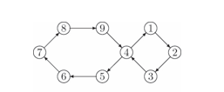

Periodicity Examples
(a)
What is the period of the above DTMC?
0.1 0.9
0.8 0.2
(b)
$$P=$$
Is this DTMC periodic or aperiodic?

